Slide 1
Ainex Competition Training
Presenter : syahmi

Slide 2
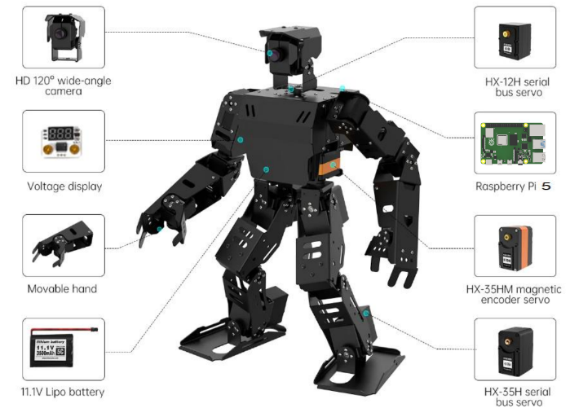
Ainex robot introduction

Slide 3
Network Configuration
Set AiNex to Client Mode (Wi-Fi)
Follow these steps to switch AiNex from AP mode to Client mode:
Edit the config files to enable Client (LAN) Mode
Enter and save your Wi-Fi SSID and password
Set a static IP address
Restart the Wi-Fi service
Reconnect using VNC with the new IP
Step by step on how to switch to client mode
https://github.com/syahmisanab/marker/tree/main/script/network_configuration

Slide 4
ROS
ROS (Robot Operating System) is an open-source framework that helps robots:
Think – process data, make decision
Communicate – share info between parts (sensors, motors, vision)
Run code in modules – reusable blocks called nodes
🔍 Why ROS for AiNex?
Built-in tools for:
Motion control
Camera streaming
Sensor data processing
Makes complex behaviors like line following or arrow detection easier to manage
Used in real-world robotics, from research to industry

Slide 5
ROS concept
Nodes
Messages and Topics
Services
ROS Master
Parameters
Stacks and packages

Slide 6
ROS basic command
roscore
rosnode
rosrun and roslaunch
rostopic
rqt

Slide 7
Python basic (ros)
Running Python Scripts
Reading & Modifying Code
Control Logic
Variables & Data
Functions
Imports & Libraries

Slide 8
Linux system
File Navigation
File management
Script
Permissions
Editing & Viewing
Terminal Shortcuts
System command

Slide 9
Docker Basics (for AiNex)
What is Docker?
A lightweight virtual container
Runs the Ainex software in a controlled, isolated environment
Think of it like a pre-packaged robot brain you can turn on/off
Why?
No Need to Install Ubuntu on Raspberry Pi
Self-Contained ROS Environment
Separates ROS from Host OS

Slide 10
Ainex controller
The AiNex Controller is a PC software tool used to:
Control and calibrate servos in real time
Design and edit action groups (e.g., walking, waving)
Test motion sequences before using them in actual scripts
Adjust servo positions and deviations with sliders or manual input
Save and load motion files used in walk_ready, stand, etc.

Slide 11
Gait Control Code (Sprint Movement)
Uses GaitManager to command the robot to walk forward, reverse, and turn
Adjust movement using parameters:
x → forward/backward speed
y → lateral movement (not used here)
yaw → rotation (turning left/right)
Includes safe start/stop of gait
Step by step on how to run code with explanation
https://github.com/syahmisanab/marker/tree/main/hurocup/Gait_Control

Slide 12
Sprint game Code
Controls a full movement cycle: walk forward → reverse
Built using GaitManager with timed actions
Code structure is simple and editable:
Change speed (x) and duration (time.sleep())
Uses OpenCV to detect a line, then triggers reverse action
Step by step on how to run code with explanation
https://github.com/syahmisanab/marker/tree/main/hurocup/Sprint_game

Slide 13
Line Following – Visual Patrol
Uses OpenCV color detection to track a black line on the ground
Defines Regions of Interest (ROIs) to focus on specific parts of the camera feed
Processes frames to detect the line's position and adjust movement
Script can be tuned for different lighting and surfaces by adjusting thresholds
Step by step on how to run code with explanation
https://github.com/syahmisanab/marker/tree/main/hurocup/Line_Following

Slide 14
Arrow detection Node
Uses OpenCV to recognize arrow shapes: left, right, and forward
Applies 7- or 9-point contour logic to distinguish arrow direction based on shape
Publishes results to the ROS topic:
Other scripts can subscribe and react to arrow data
Step by step on how to run code with explanation
https://github.com/syahmisanab/marker/tree/main/hurocup/Arrow_Detection

Slide 15
Marathon game
Combines two key systems
Line Following → Arrow Detection → Movement Decision
Robot follows the line, detects arrow direction, and turns or walks forward
Logic includes:
Turn left/right based on /arrow/shape_direction
Keep following if arrow points forward
Full mission script to test complete game flow from start to finish
Step by step on how to run code with explanation
https://github.com/syahmisanab/marker/tree/main/hurocup/Marathon_game

